Slide 1
DATA LOGGER CIRCUIT
V2.0

Slide 2
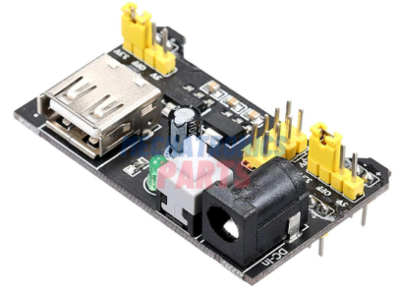
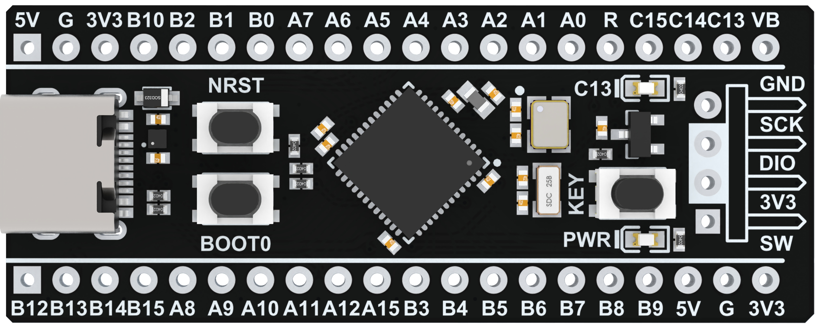
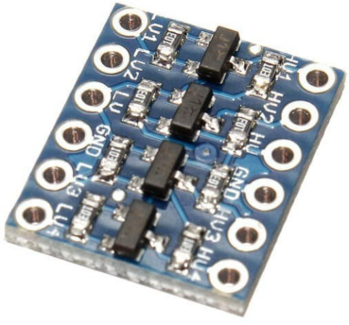
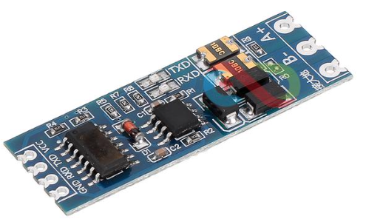
POWER SUPPLY FOR
MB102 BREADBOARD
3.3V/5V MODULE
3.3V
Ch.2
Ch.4
Board Connector for input voltage 9-12V
GND
Ch.6
Ch.1
GND
+
5V
-
3.3V
A7
A5
A1
A0
STM32F411CEU6
STM32 BLACKPILL
A8
A11
A12
B7
TX
RX
Ch.5
Ch.3
Rx
3.3V
3.3V
Tx
GND
GND
GND
3.3V
Ch.5
Ch.3
Ch.1
LV4
LV3
GND
LV
LV2
LV1
Ch.6
Ch.4
Ch.2
4 Channel I2C Logic Level Converter Bi-Directional Module 5v To 3.3v
LV4
LV3
GND
LV
LV2
LV1
LV4
LV3
GND
LV
LV2
LV1
4 Channel I2C Logic Level Converter Bi-Directional Module 5v To 3.3v
HV4
HV3
GND
HV
HV2
HV1
MAX485 TTL TO RS485
MODULE 485 TO SERIAL PORT UART LEVEL
GND
5V
5V
VCC
RX
A+
HV4
HV3
GND
HV
HV2
HV1
HV4
HV3
GND
HV
HV2
HV1
TX
B-
5V
Ch.6
Ch.4
Ch.2
5V
GND
GND
Ch.5
Ch.3
Ch.1
GND
GND
Board Connector for output RS485 signal
10 12 8
2 4 6
74LS14 (Schmitt Trigger)
Board Connector for input TTL signal
11 13 9
1 3 5
Board Connector for input (non TTL) signal

